Slide 1
THE LIFE OF CHRIST
PART 52

Slide 2
John 7:37 On the last day, that great day of the feast, Jesus stood and cried out, saying, "If anyone thirsts, let him come to Me and drink. ³⁸ "He who believes in Me, as the Scripture has said, out of his heart will flow rivers of living water." ³⁹ But this He spoke concerning the Spirit, whom those believing in Him would receive; for the Holy Spirit was not yet given, because Jesus was not yet glorified.

Slide 3
Each day, during the feast a priest carried a golden pitcher to the pool (of Siloam), filled it and returned to the court of the temple, accompanied by throngs of people rejoicing greatly and poured it on the altar. Immediately, the Hallel, consisting of Ps. 113 -118 was chanted by the Levites and the people repeated each line after the priests. It was a ceremony of much joy and satisfaction. Ancient rabbis are quoted as having said that he who had never witnessed this ceremony did not really know what rejoicing meant. At the close of the singing of the Hallel there was a pause in the activities and it was evidently at this moment that the voice of the Lord rang out... (Woods, p. 155).

Slide 4
On each of the seven preceding days water was drawn in a golden pitcher from the pool of Siloam and carried in procession to the temple and offered by the priests as the singers chanted Isa 12:3: "With joy shall ye draw water out of the wells of salvation..." (Westcott).
Ex. 17:5-6; Num. 20:7-11; Joel 2:28; Acts 2:1-4, 16-17

Slide 5
John 7:40 Therefore many from the crowd, when they heard this saying, said, "Truly this is the Prophet." ⁴¹ Others said, "This is the Christ." But some said, "Will the Christ come out of Galilee? ⁴² "Has not the Scripture said that the Christ comes from the seed of David and from the town of Bethlehem, where David was?" ⁴³ So there was a division among the people because of Him. ⁴⁴ Now some of them wanted to take Him, but no one laid hands on Him.
Deut: 18: 15, 19; Mic. 5:2

Slide 6
John 7:45 Then the officers came to the chief priests and Pharisees, who said to them, "Why have you not brought Him?" ⁴⁶ The officers answered, "No man ever spoke like this Man!"

Slide 7
John 7:47 Then the Pharisees answered them, "Are you also deceived? ⁴⁸ "Have any of the rulers or the Pharisees believed in Him? ⁴⁹ "But this crowd that does not know the law is accursed."

Slide 8
F.F. Bruce writes:
Even the liberal Rabbi Hillel, of the generation before Christ, summed up this attitude when he said, “No member of the common people is pious”. From the Pharisees point of view, the common people could easily be misled by any plausible teacher, because of their shocking ignorance of the true interpretation of the law (F.F. Bruce The Gospel & Epistles of John p.185).

Slide 9
1 Corinthians 1:27 But God has chosen the foolish things of the world to put to shame the wise, and God has chosen the weak things of the world to put to shame the things which are mighty;
1 Corinthians 3:18 Let no one deceive himself. If anyone among you seems to be wise in this age, let him become a fool that he may become wise. ¹⁹ For the wisdom of this world is foolishness with God. For it is written, "He catches the wise in their own craftiness"; ²⁰ and again, "The LORD knows the thoughts of the wise, that they are futile."

Slide 10
Proverbs 3:7 Do not be wise in your own eyes; Fear the LORD and depart from evil.
Proverbs 12:15 The way of a fool is right in his own eyes, But he who heeds counsel is wise.
Romans 12:16 Be of the same mind toward one another. Do not set your mind on high things, but associate with the humble. Do not be wise in your own opinion. (See also Isa. 5:21).

Slide 11
John 7:50 Nicodemus (he who came to Jesus by night, being one of them) said to them, ⁵¹ "Does our law judge a man before it hears him and knows what he is doing?"
Ex. 23:1; Deut. 1:16

Slide 12
“Flesh and blood may pass judgment on a man if it hears his words; if it does not hear them, it cannot establish its judgment” (F.F. Bruce The Gospel & Epistles of John p.186).

Slide 13
John 7:52 They answered and said to him, "Are you also from Galilee? Search and look, for no prophet has arisen out of Galilee." ⁵³ And everyone went to his own house.
Isaiah 9:1-3; Mt. 4:12-16

Slide 14
John 8:1 But Jesus went to the Mount of Olives. ² Now early in the morning He came again into the temple, and all the people came to Him; and He sat down and taught them. ³ Then the scribes and Pharisees brought to Him a woman caught in adultery. And when they had set her in the midst, ⁴ they said to Him, "Teacher, this woman was caught in adultery, in the very act. ⁵ "Now Moses, in the law, commanded us that such should be stoned. But what do You say?" ⁶ This they said, testing Him, that they might have something of which to accuse Him. But Jesus stooped down and wrote on the ground with His finger, as though He did not hear.

Slide 15
⁷ So when they continued asking Him, He raised Himself up and said to them, "He who is without sin among you, let him throw a stone at her first." ⁸ And again He stooped down and wrote on the ground. ⁹ Then those who heard it, being convicted by their conscience, went out one by one, beginning with the oldest even to the last. And Jesus was left alone, and the woman standing in the midst. ¹⁰ When Jesus had raised Himself up and saw no one but the woman, He said to her, "Woman, where are those accusers of yours? Has no one condemned you?" ¹¹ She said, "No one, Lord." And Jesus said to her, "Neither do I condemn you; go and sin no more."

Slide 16
J.W. McGarvey made this valid point:
This section is wanting in nearly all older manuscripts, but Jerome (A.D. 346-420) says that in his time it was contained “in many Greek and Latin manuscripts,” and these must have been as good or better than the best manuscripts we now possess (J. W. McGarvey, The Fourfold Gospel p. 544).

Slide 17
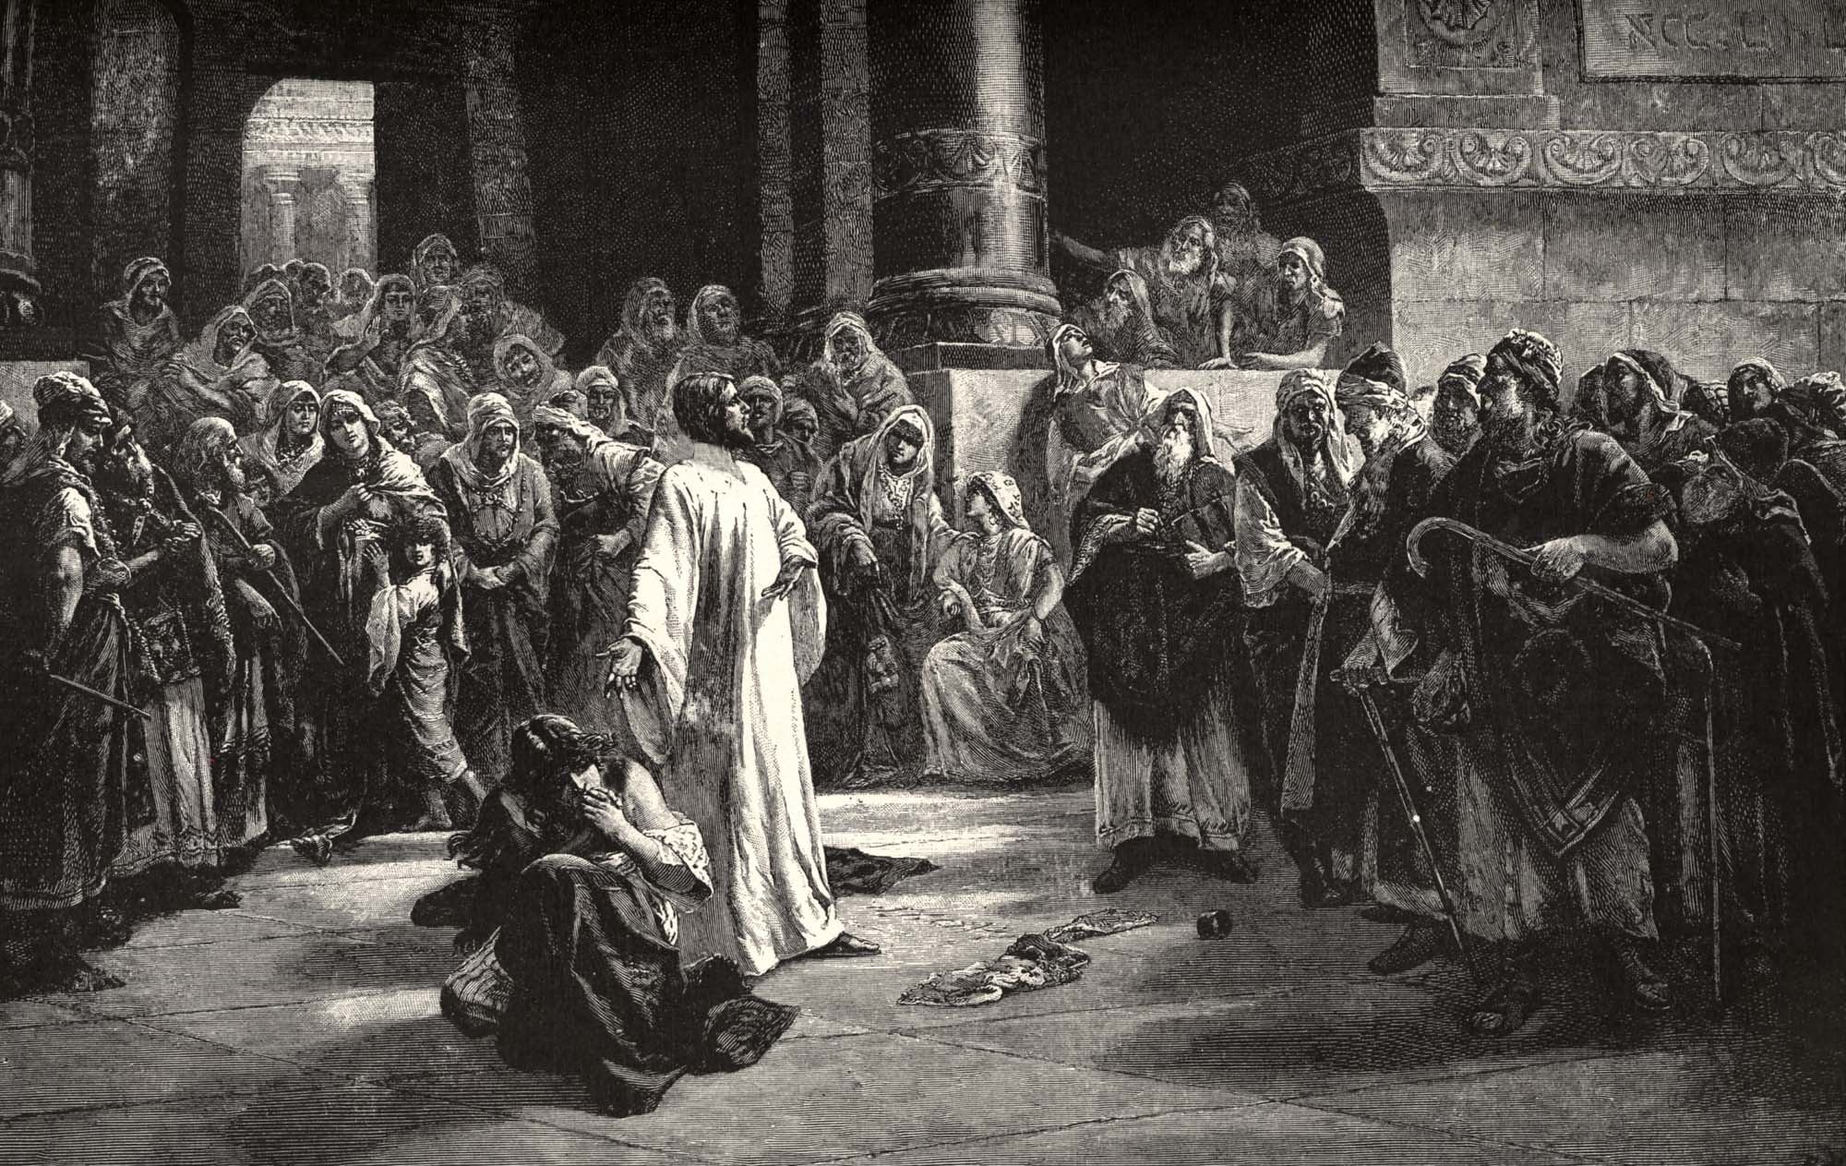

Slide 18
Deuteronomy 22:22 " If a man is found lying with a woman married to a husband, then both of them shall die -- the man that lay with the woman, and the woman; so you shall put away the evil from Israel. ²³ " If a young woman who is a virgin is betrothed to a husband, and a man finds her in the city and lies with her, ²⁴ "then you shall bring them both out to the gate of that city, and you shall stone them to death with stones, the young woman because she did not cry out in the city, and the man because he humbled his neighbor's wife; so you shall put away the evil from among you.

Slide 19
Leviticus 20:10 'The man who commits adultery with another man's wife, he who commits adultery with his neighbor's wife, the adulterer and the adulteress, shall surely be put to death.

Slide 20
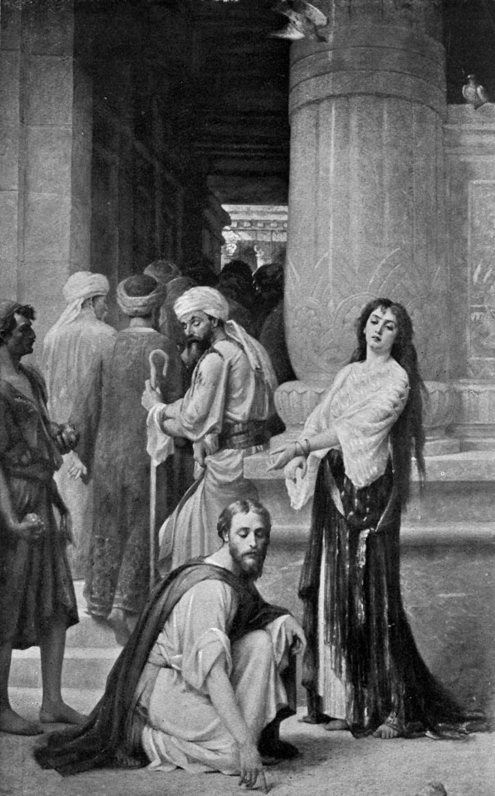

Slide 21
Romans 2:1 Therefore you are inexcusable, O man, whoever you are who judge, for in whatever you judge another you condemn yourself; for you who judge practice the same things. ² But we know that the judgment of God is according to truth against those who practice such things. ³ And do you think this, O man, you who judge those practicing such things, and doing the same, that you will escape the judgment of God?

Slide 22
“Do not judge according to appearance, but judge with righteous judgment (Jn. 7:24).”

Slide 23
Matthew 18:15 " Moreover if your brother sins against you, go and tell him his fault between you and him alone. If he hears you, you have gained your brother. ¹⁶ "But if he will not hear, take with you one or two more, that 'by the mouth of two or three witnesses every word may be established.' ¹⁷ "And if he refuses to hear them, tell it to the church. But if he refuses even to hear the church, let him be to you like a heathen and a tax collector. ¹⁸ "Assuredly, I say to you, whatever you bind on earth will be bound in heaven, and whatever you loose on earth will be loosed in heaven.

Slide 24
Luke 17:3 "Take heed to yourselves. If your brother sins against you, rebuke him; and if he repents, forgive him.
James 5:19 Brethren, if anyone among you wanders from the truth, and someone turns him back, ²⁰ let him know that he who turns a sinner from the error of his way will save a soul from death and cover a multitude of sins.

Slide 25
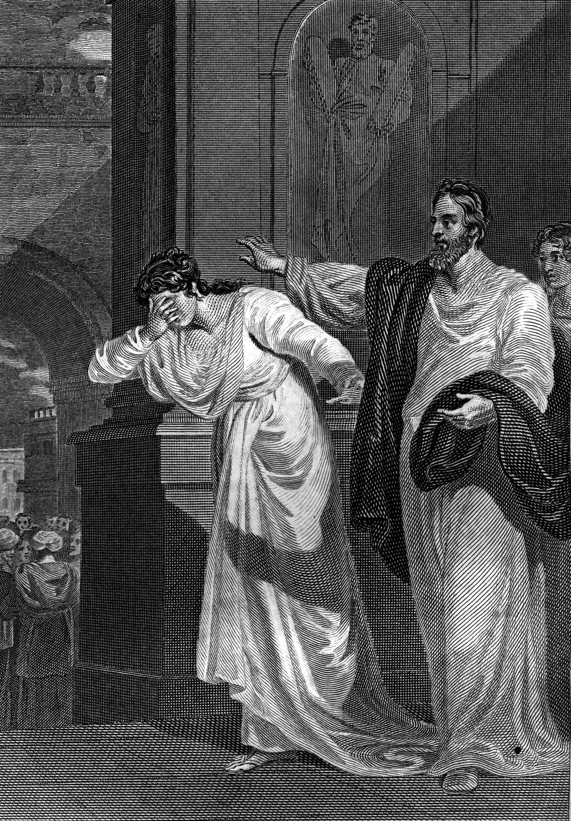
“Go and sin no more.”

